Slide 1
Linear Regression

Slide 2
Outline
Linear regression
Why?
What it is?
Estimation of coefficients
Least square approximation
Gradient descent Method
Numerical Question
Multivariate Linear regression method
Why?
Estimation of coefficients
Gradient descent Method
Normal Equation

Slide 3
Why Linear Regression?
Advertising example
Sales (in thousands of units) for a particular product as a function of advertising budgets (in thousands of dollars) for TV, radio, and newspaper media
Objective:
Recommend a marketing plan for next year that will result in high product sales.
Question?
What information would be useful in order to provide such a recommendation?

Slide 4
Why Linear Regression?
Is there a relationship between advertising budget and sales?
Evidence of an association between
How strong is the relationship between advertising budget and sales?
Strength of this relationship
Which media contribute to sales?
Do just one or two of the media contribute?

Slide 5
Why Linear Regression?
How accurately can we estimate the effect of each medium on sales?
By what amount will sales increase?
How accurately can we predict future sales?
what is the accuracy of this prediction
Is the relationship linear?
Is there synergy among the advertising media?
Interaction effect

Slide 6

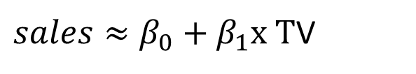

What is Linear Regression?
coefficients or parameters
Modelling
The estimated value for an unknown parameter or coefficient

Slide 7
Linear Regression: Estimation of Coefficients
Measuring closeness
Best one is: Minimizing the least squares criterion

Slide 8
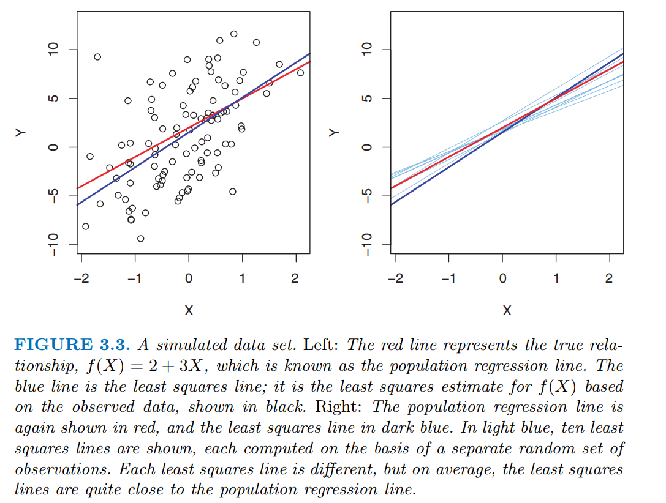
Linear Regression: Estimation of Coefficients

Slide 9



Least Square Error
Residual sum of square
Using Least Square Approach:

Slide 10
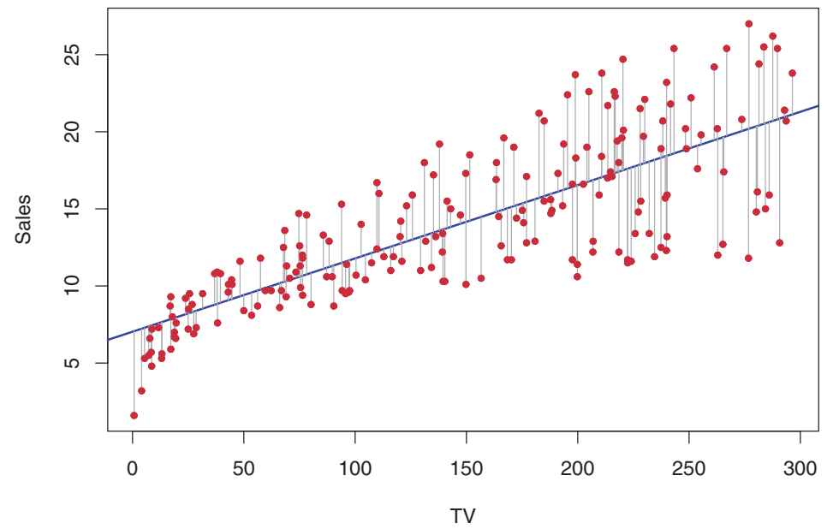
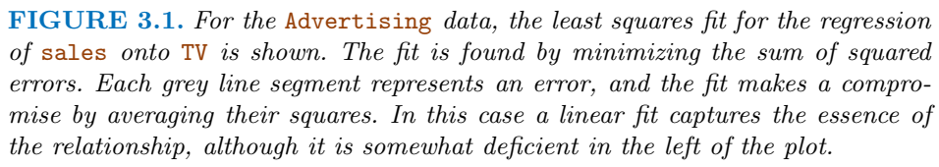
Linear Regression contd…

Slide 11
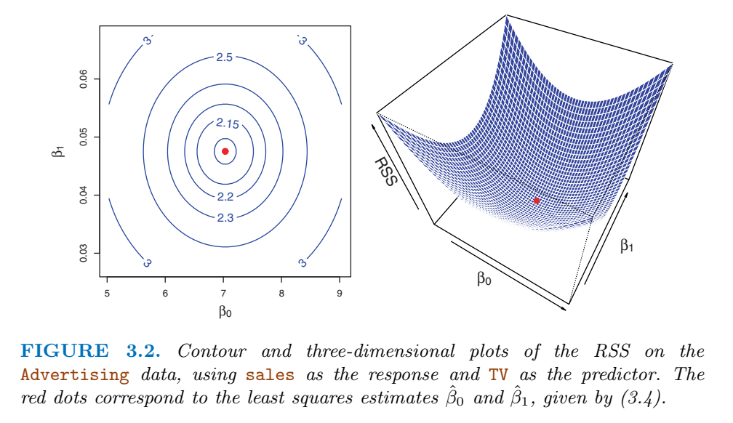
Linear Regression contd…

Slide 12
Question
Consider the following set of points: {(-2 , -1) , (1 , 1) , (3 , 2)}
a) Find the least square regression line for the given data points.
b) Plot the given points and the regression line in the same rectangular system of axes.
c) Find the value of y for x=0.

Slide 13



























Slide 14











































Slide 15















Slide 16
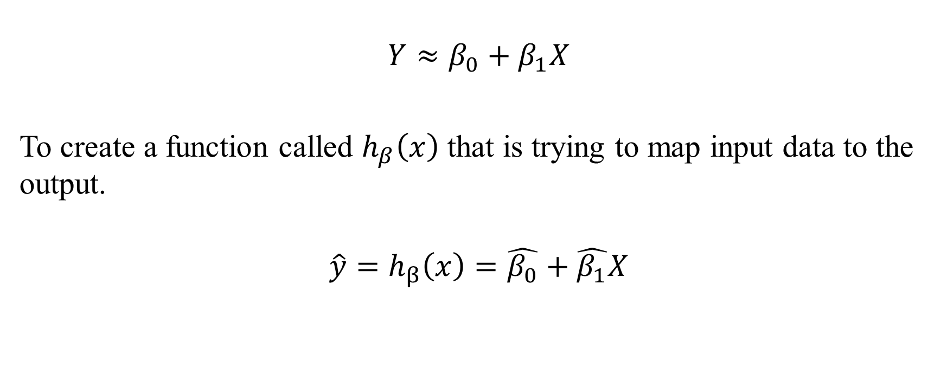
Hypothesis function

Slide 17
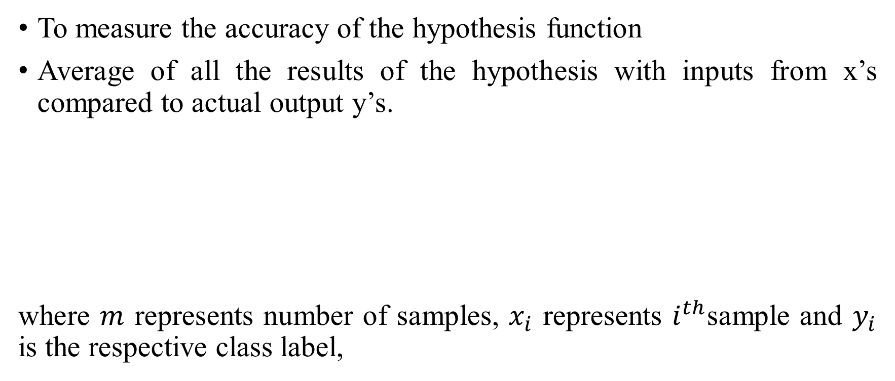
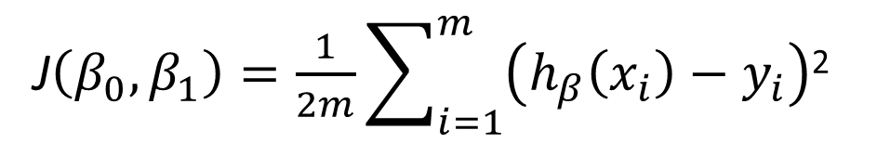
Cost function

Slide 18
Gradient Descent Approach

Slide 19
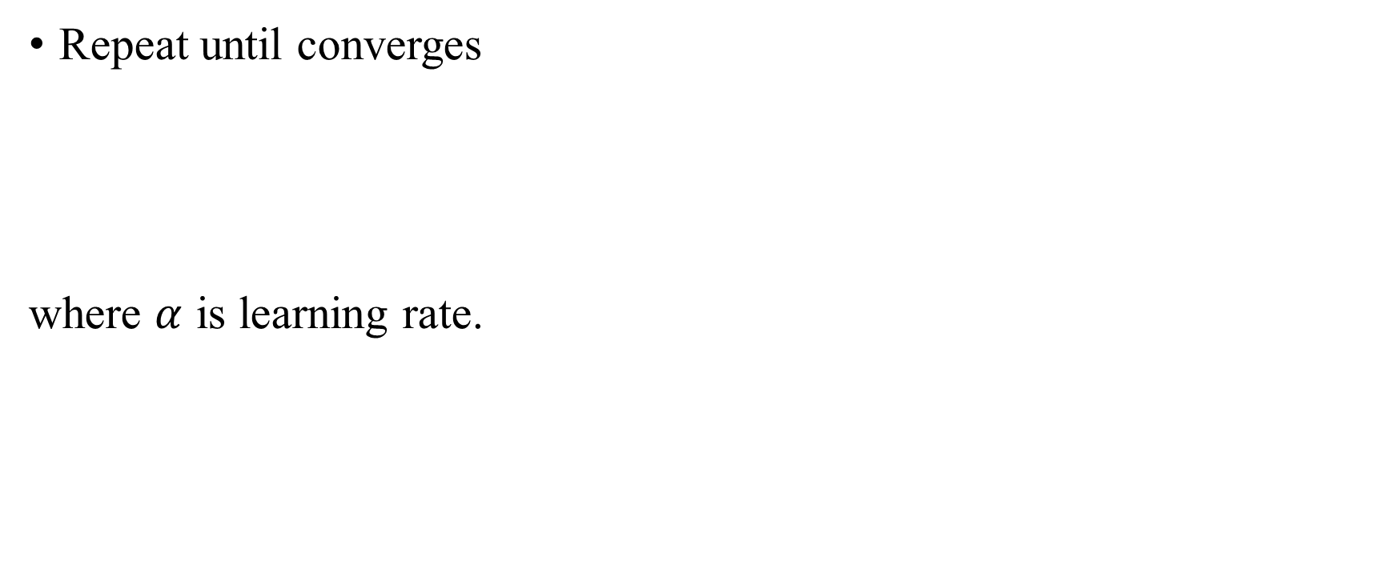
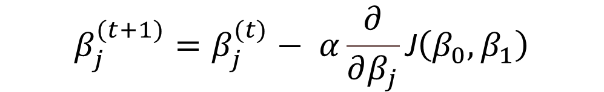
Gradient Descent Approach

Slide 20
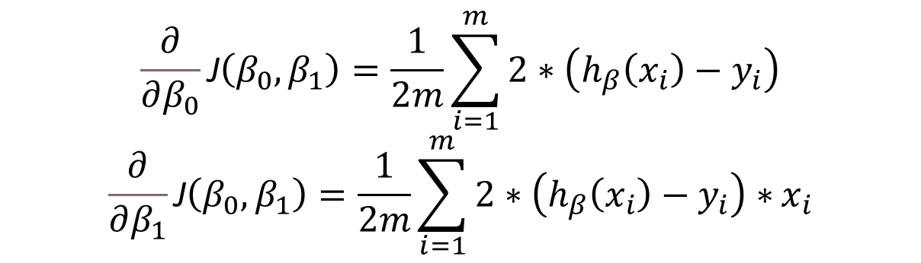
Gradient Descent Approach

Slide 21
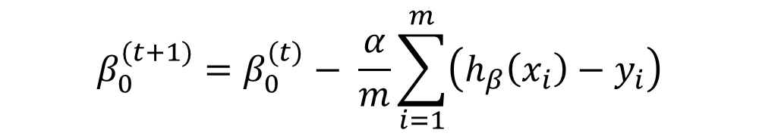
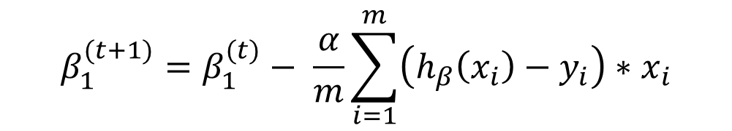
Gradient Descent Approach
Repeat until converges

Slide 22
Question
The values of x and their corresponding values of y are shown in the table below
x: 0 1 2 3 4 y: 2 3 5 4 6
a) Find the least square regression line y = ax + b. b) Estimate the value of y when x = 10.

Slide 23




















Slide 24


Slide 25
Linear Regression – Accessing the accuracy of the coefficients
Population regression line
If f(X) is linear function,
Example,

Slide 26
Linear Regression – Accessing the accuracy of the model
The quality of a linear regression fit
The residual standard error (RSE) and
The R² statistic

Slide 27
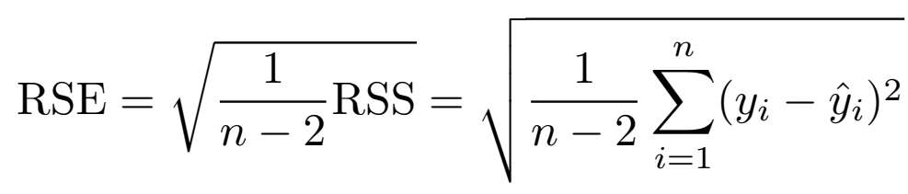
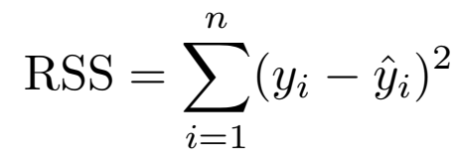
Linear Regression – Accessing the accuracy of the model
The residual standard error (RSE)
Measure of lack of fit of the model

Slide 28
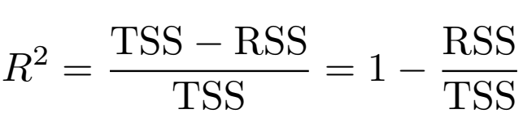

Linear Regression – Accessing the accuracy of the model
R²
The proportion of variance explained
Always takes on a value between 0 and 1, and
Independent of the scale of Y
Total sum of squares

Slide 29
Linear Regression – Accessing the accuracy of the model
TSS measures the total variance in the response Y ,
The amount of variability inherent in the response before the regression is performed.
RSS measures
The amount of variability that is left unexplained after performing the regression.
TSS – RSS measures
The amount of variability in the response that is explained (or removed) by performing the regression,

Slide 30
Linear Regression – Accessing the accuracy of the model
R² measures
proportion of variability in Y that can be explained using X.
R² =1 (when we fit our curve exactly)
A large proportion of the variability in the response has been explained by the regression
A small RSS means the predicted values are close to the actual data, indicating a good fit of the regression model.
A large RSS suggests a poor fit, meaning the model's predictions deviate significantly from the actual data.

Slide 31
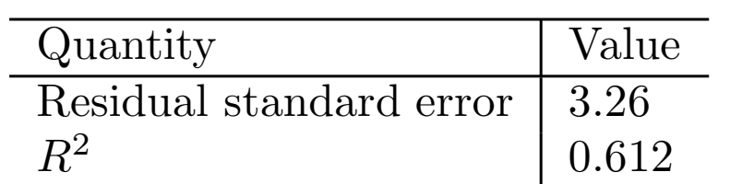
Linear Regression – Accessing the accuracy of the model

Slide 32



Multivariate Linear Regression
Advertising example
Sales (in thousands of units) for a particular product as a function of advertising budgets (in thousands of dollars) for TV, radio, and newspaper media

Slide 33



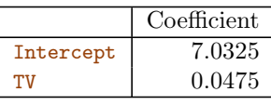
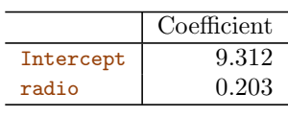
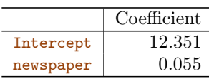
Multivariate Linear Regression
Problems:
It is unclear how to make a single prediction of sales given levels of the three advertising media budgets, since each of the budgets is associated with a separate regression equation.
Each of the three regression equations ignores the other two media in forming estimates for the regression coefficients.

Slide 34
Multivariate Linear Regression
In general, Multivariate Linear Regression:
where,
n=number of features
m= number of samples

Slide 35
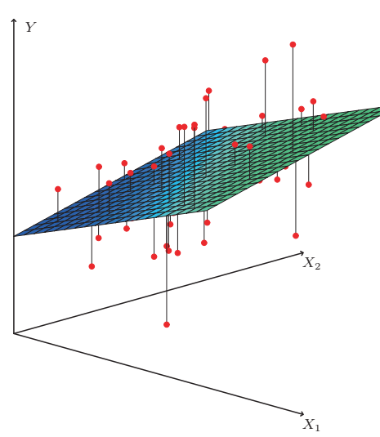
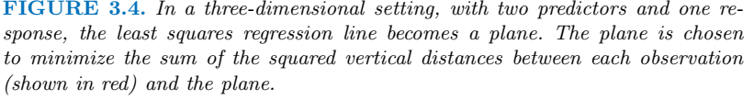
Multivariate Linear Regression

Slide 36
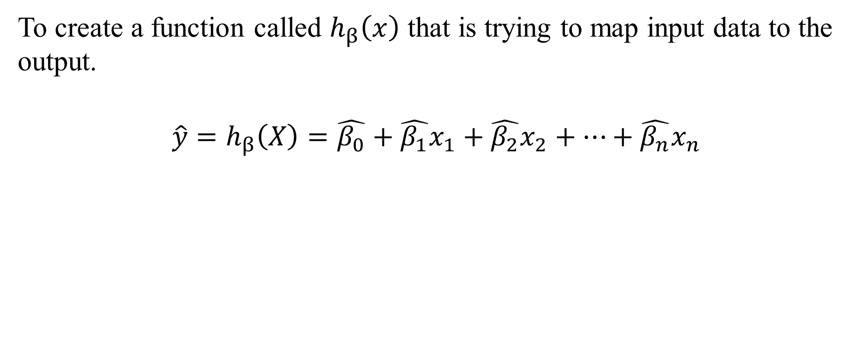
Hypothesis function

Slide 37
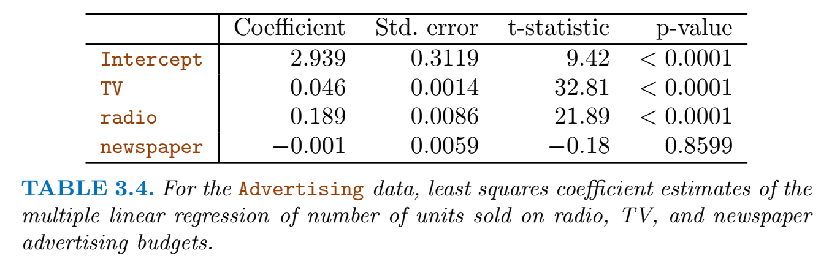
Linear Regression – Accessing the accuracy of the model

Slide 38

Matrix Representation

Slide 39

Cost function
To measure the accuracy of the hypothesis function
Average of all the results of the hypothesis with inputs from x’s compared to actual output y’s.

Slide 40
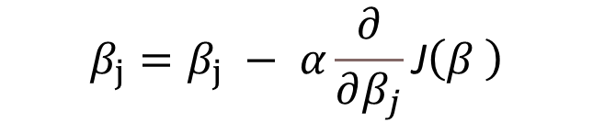

Gradient descent method
Repeat until converges
Matrix notation:

Slide 41
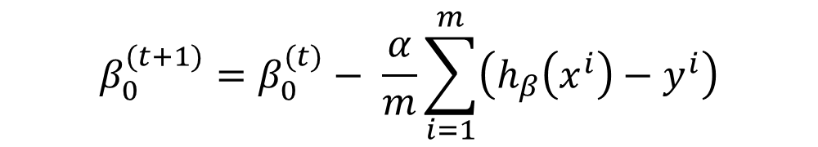
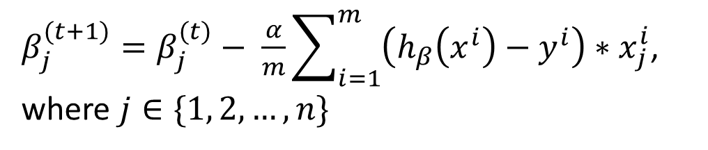
Gradient descent method

Slide 42
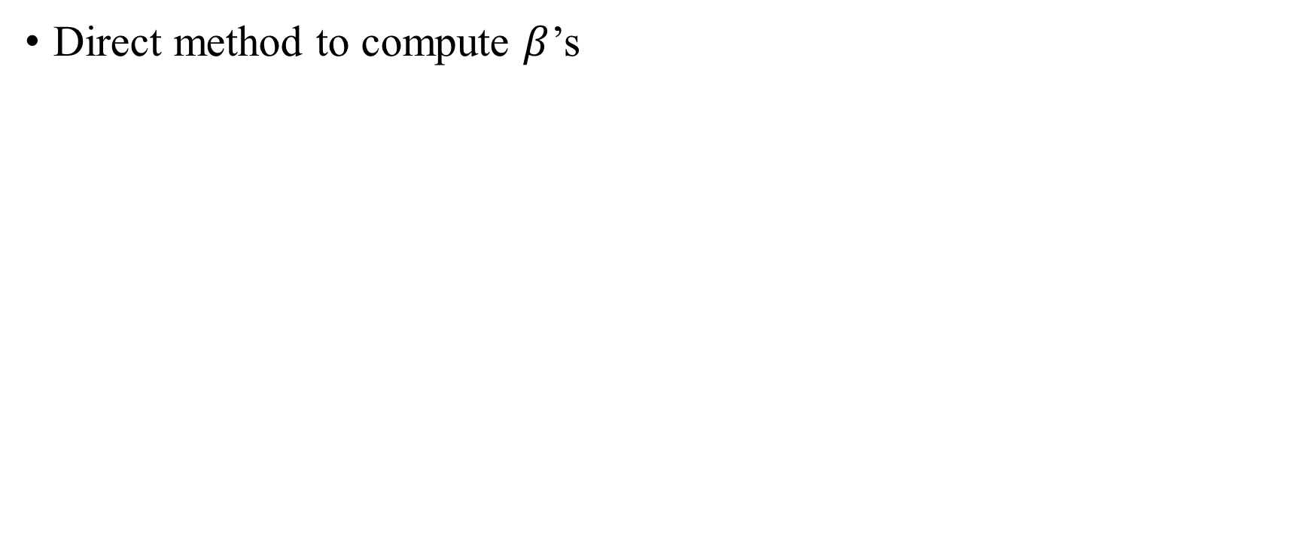
Normal equation method

Slide 43
Gradient descent method vs Normal Equation Method
 | Gradient Descent | Normal Eq
Complexity | O(kn²) | O(n³)
Learning Rate | Required | No
Iteration | Many iterations | No iteration

Slide 44
Practice Question
The sales of a company (in million dollars) for each year are shown in the table below. x (year) 2005 2006 2007 2008 2009 y (sales) 12 19 29 37 45
a) Find the least square regression line y = ax + b. b) Use the least squares regression line as a model to estimate the sales of the company in 2012.
Find the solution using
Direct formulas
Gradient Descent

Slide 45
















Slide 46














Slide 47
Questions
Linear Regression is a ___________ machine learning algorithm.
In a simple linear regression model (One independent variable), If we change the input variable by 1 unit. How much output variable will change?
In the mathematical Equation of Linear Regression Y = β1 + β2X + ϵ, (β1, β2) refers to __________
Supervised
Regression Coefficients

Slide 48
In a simple linear regression model (One independent variable),
If we change the input variable by 1 unit. How much output variable will change?
In a simple linear regression model of the form:
Sol:-
y=ax+b
where y is the dependent (output) variable and x is the independent (input)
variable, the coefficient a represents the slope of the line.
Meaning of the slope a:
The slope a tells us how much the output variable y will change for a
one-unit change in the input variable xxx.
Specifically, if x increases by 1 unit, y will change by a units.
For example, if the equation is y=2x+5, the slope a=2 means that for each 1 unit
increase in x, the output y increases by 2 units.
Thus, in simple linear regression, the output variable changes by the value
of the slope a for every unit change in the input variable x.

Slide 49
Questions
How many coefficients do you need to estimate in a simple linear regression model with two independent variables?
If Linear regression model perfectly fits i.e., train error is zero, then test error _____________________
Line of best fit or regression line is found when _____________
Likely to be non-zero and may be quite high
Sum of the squared differences between the observed values and the
predicted values(the residuals)is minimized

Slide 50
How many coefficients do you need to estimate in a simple linear regression model with two independent variables?
Sol:-
In a simple linear regression model with two independent variables, the model takes the form:
y=a1x1+a2x2+b
Here:
y is the dependent (output) variable.
x1 and x2​ are the two independent (input) variables.
a1 and a2​ are the coefficients (slopes) for each independent variable.
b is the intercept.
Number of coefficients to estimate:
In this model, you need to estimate:
a1​: the coefficient for x1​.
a2​: the coefficient for x2​.
b: the intercept (the value of y when both x1​ and x2​ are zero).
Therefore, you need to estimate three coefficients in total: two slope coefficients (a1 and a2​) and one intercept
coefficient (b).

Slide 51
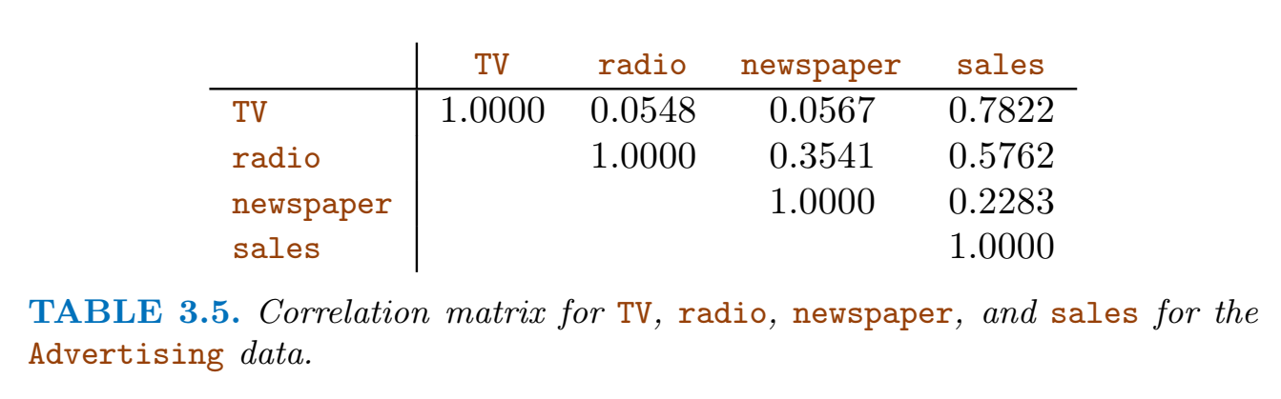
Linear Regression contd…
Question: Does it make sense for the multiple regression to suggest no relationship between sales and newspaper while the simple linear regression implies the opposite?
Solution: Do co-relation analysis
Newspaper sales are a surrogate for radio advertising; newspaper gets “credit” for the effect of radio on sales.

Slide 52
Linear Regression contd…
Advertising example
The average effect on sales of a one-unit increase in TV is always β₁, regardless of the amount spent on radio
The change in the response Sales due to a one-unit change in TV is constant. It does not depends on TV

Slide 53
Linear Regression contd…
Assumptions
Additive assumption
The effect of changes in a predictor X_{j} on the response Y is independent of the values of the other predictors.
Linear assumption
The change in the response Y due to a one-unit change in X_{j} is constant, regardless of the value of X_{j}

Slide 54

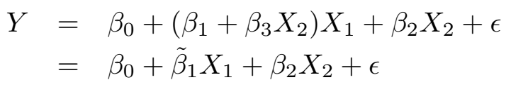
Linear Regression contd… (Additive assumption)
Advertising example
The average effect on sales of a one-unit increase in TV is always β₁, regardless of the amount spent on radio
NOT TRUE

Slide 55
Linear Regression contd… (Additive assumption)
Example
Production lines, worker and unit produced
Predictor
Response

Slide 56
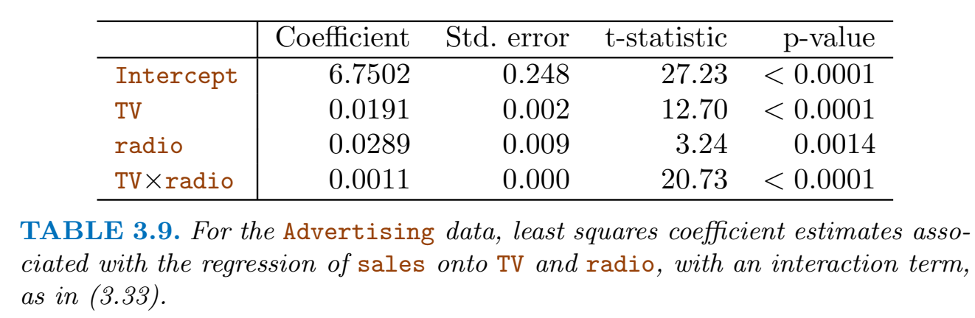
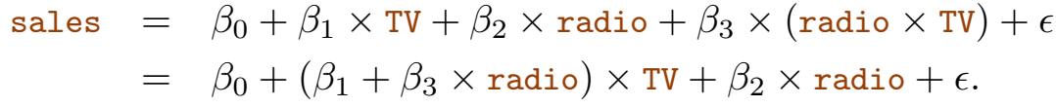
Linear Regression contd… (Additive assumption)

Slide 57
Linear Regression contd… (Additive assumption)
Hierarchical principle
if include an interaction in a model, hierarchical should also include the main effects, even if the p-values associated with principle their coefficients are not significant.

Slide 58
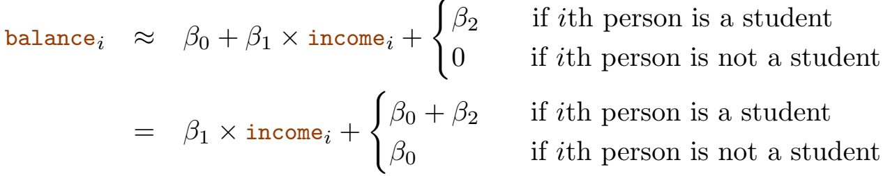
Linear Regression contd… (Additive assumption)
Example: Credit data set
Suppose that we wish to predict balance using the income (quantitative) and student (qualitative) variables.
In the absence of an interaction term, the model takes the form

Slide 59
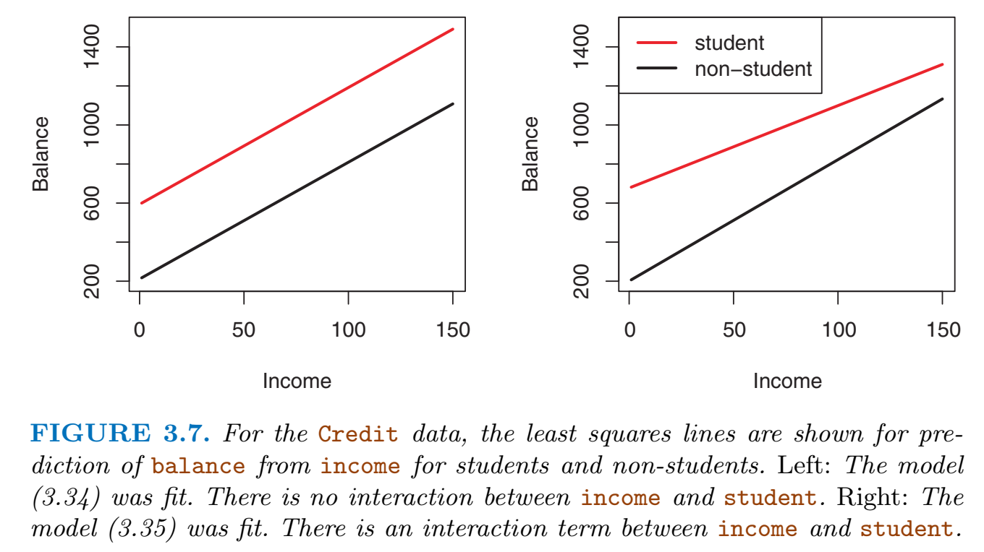
Linear Regression contd… (Additive assumption)

Slide 60
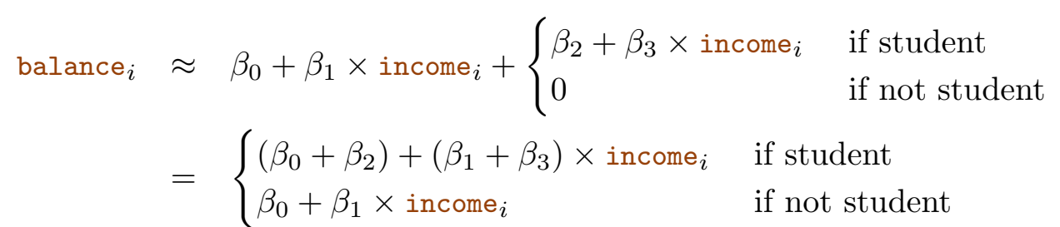
Linear Regression contd… (Additive assumption)

Slide 61
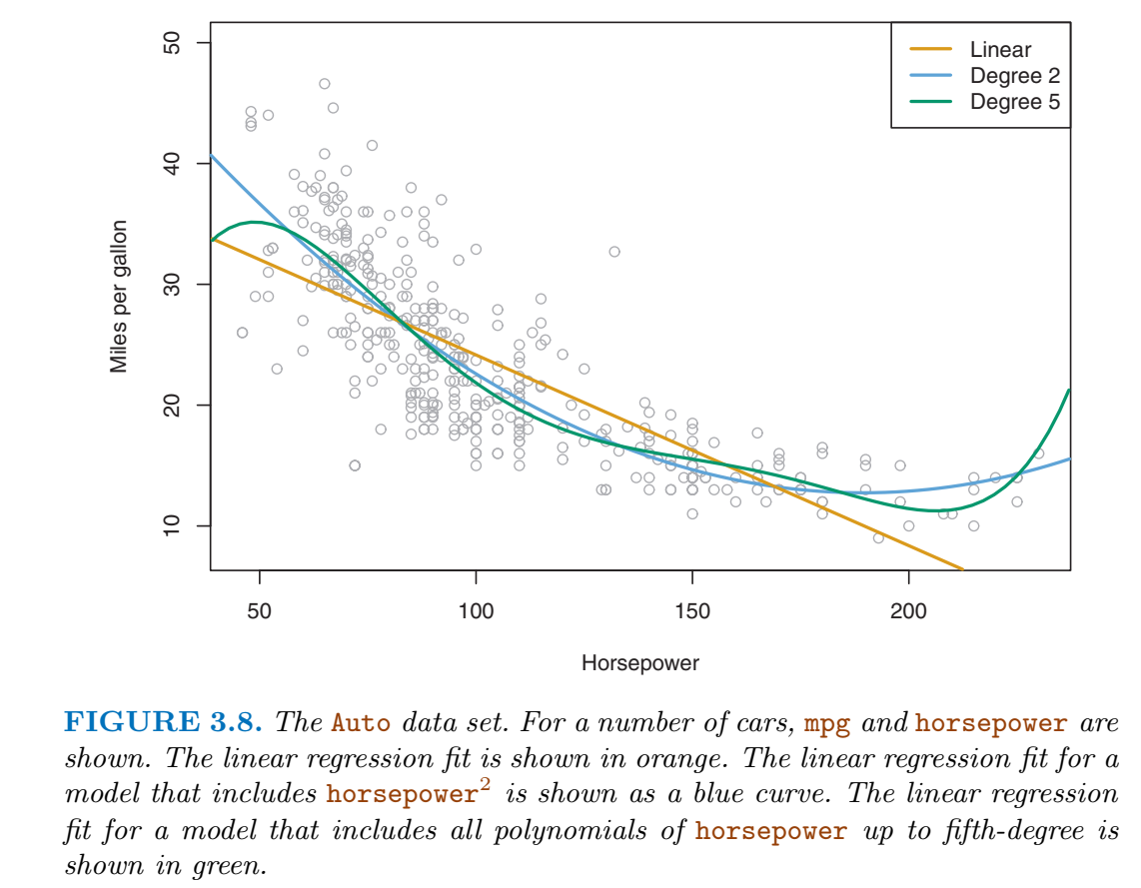
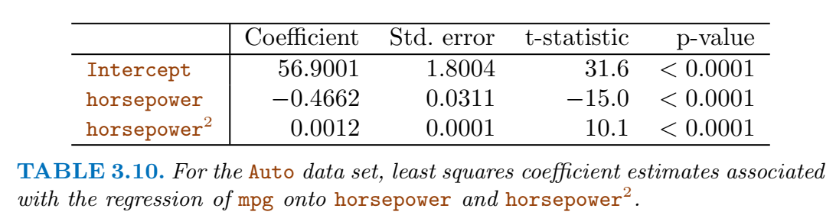
Linear Regression contd… (Linear assumption)
mpg (gas mileage in miles per gallon) versus horsepower is shown for a number of cars in the Auto data set

Slide 62
Linear Regression contd…
Potential Problems
1. Non-linearity of the response-predictor relationships.
2. Correlation of error terms.
3. Non-constant variance of error terms.
4. Outliers.
5. High-leverage points.
6. Collinearity.

Slide 63
Linear Regression contd…
Is there a relationship between advertising budget and sales?
Evidence of an association between
How strong is the relationship between advertising budget and sales?
Strength of this relationship
Which media contribute to sales?
Do just one or two of the media contribute?

Slide 64
Linear Regression contd…
How accurately can we estimate the effect of each medium on sales?
By what amount will sales increase?
How accurately can we predict future sales?
what is the accuracy of this prediction
Is the relationship linear?
Is there synergy among the advertising media?
Interaction effect

Slide 65
References
Gareth James, Daniela Witten, Trevor Hastie, Robert Tibshirani, An Introduction to Statistical Learning with Applications in R, Springer, 2013

